Slide 1
OBI tutorial
ICBO 2011
7/27/2011, Buffalo, NY

Slide 2
Tutorial Overview
OBI – high level
OBI applications
Break
Hands on session

Slide 3
Software - preparation
Instructions were emailed
Before hands-on session, please minimally
Install Protégé 4.1
Load OBI
Run Reasoner
Let me know if you have problems

Slide 4
OBI – a high level overview
Bjoern Peters
3/21/2011
San Diego Workshop

Slide 5
OBI – a user driven project
19 communities that recognized they were trying to solve the same / related problems
6 year effort
1-2 phone calls per week, 1-2 meetings per year
first stable release (Philly / 1.0) in Oct. 2009
→ Open project with constant addition of new communities, please consider joining!

Slide 6
OBI Timeline
MO/ MAGE
FuGO
FuGE
OBI
2004 2005 2006 2007
MAGE
Jamboree
Hinxton
Dec
1st FuGO
Workshop
Philadelphia
Feb.
2nd FuGO
Workshop
Hinxton
July
OBI Workshop San Diego Jan.
SOFG
Philadelphia
Oct
MAGE
Jamboree
Stanford
March
MGED 8
Bergen
Sept.
Transcriptomics (MGED)
Proteomics (PSI)
PSI
Siena
April
Cancer Genomics
Polypmorphisms
Genome Sequences
Crop Sciences
Toxicogenomics
Environmental Genomics
Nutrigenomics
(MGED RSBI)
Metabolomics
Flow Cytometry
Cellular Assays Immport IEDB Neuroinformatics
From Jan, 2007 OBI workshop in LIAI

Slide 7
OBI Timeline
OBI 1.0.X
OBI RC1
OBI RC2
2007 2008 2009 2010 2011
Workshops: Bethesda Vancouver EBI EBI Philly Vancouver San Diego
DENRIE -> IAO
OBO Foundry
MIREOT
J Biomed Sem.
Bio-imaging,
Clinical Investigations,
Electrophysiology,
Structural Biology
Robot
Scientists
Vaccines
Eagle-i

Slide 8
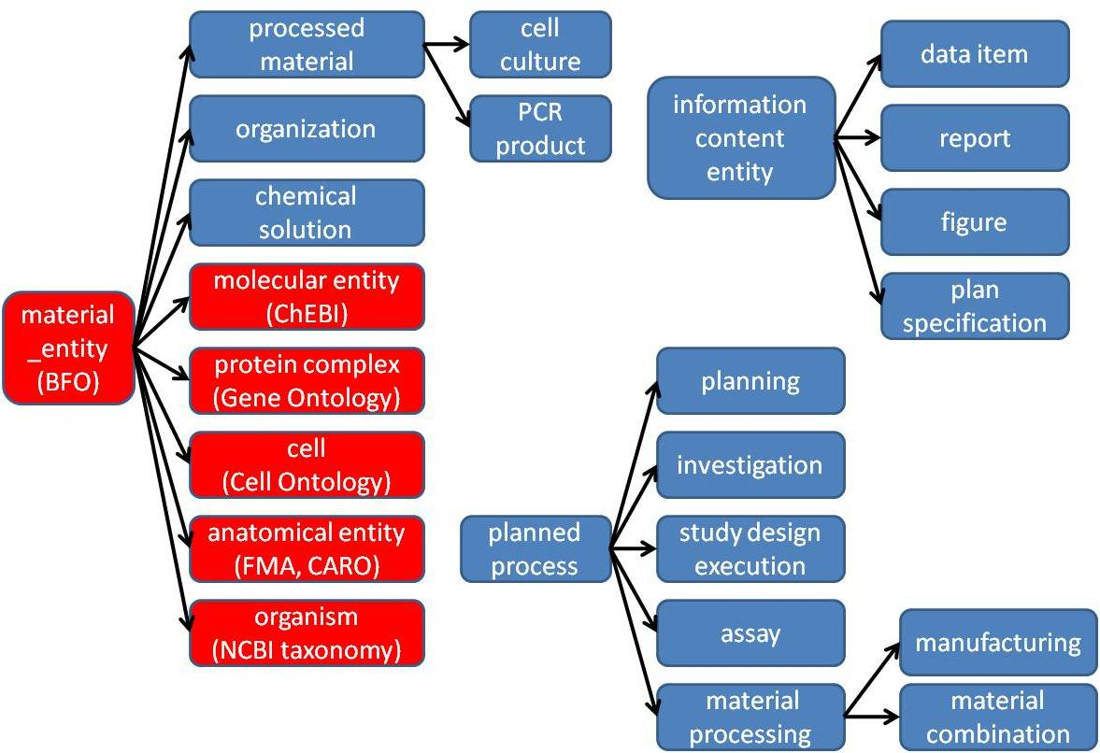
High level class hierarchy
Notes:
Remove planning

Slide 9
material entity
merged bfo:object, object part, object aggregate (what is a cell inside my body?)
import ‘natural biomaterials’ (MIREOT mechanism), e.g. organism (NCBI taxonomy), anatomical entity (FMA), molecular entity (ChEBI)
OBI’s primary scope
‘processed material entities’
output of a planned material transformation process
would not exist without intelligent life around
some ‘natural biomaterials’ can also be created (e.g. molecules) → no asserted disjoint
specimen, study subject
material entities about which information is gathered during an investigation
may or may not be processed materials

Slide 10
planned process
realize a ‘plan specification’ which includes an ‘objective specification’ (describing the desired endpoint)
have specified inputs and outputs (=participants called out in the specification)
high level classes:
material processing
assay
data transformation

Slide 11
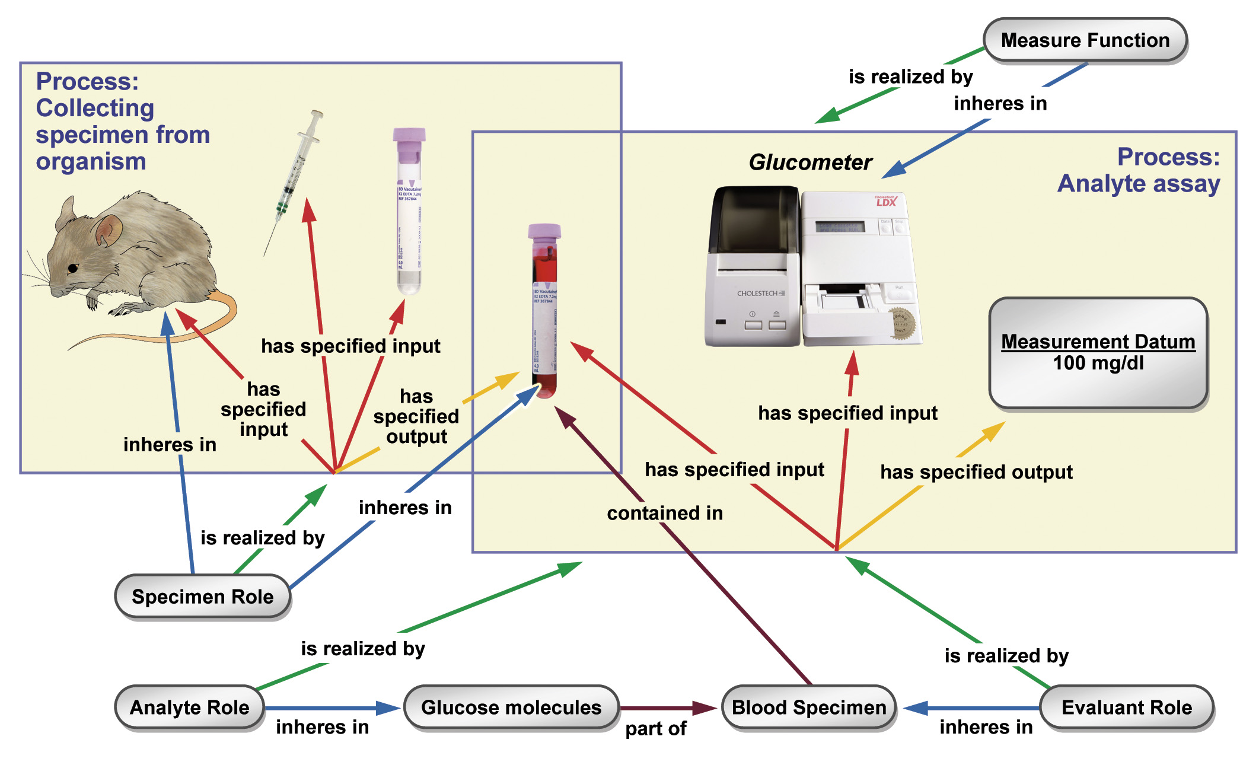

Slide 12
information content entities
IAO, separate effort spawned of from OBI, but tightly interlinked
every information content entity is_about something
Examples: plan specification, journal article, data item
OBI subclasses these, e.g.: study design, dependent variable specification, measurement datum

Slide 13
More classes
roles – specimen role, author role
functions – contain function, measurement function
organizations – manufacturer, regulatory agency

Slide 14
Conclusions
core structure is in place, solidified over several years, and now usable
design process has been formalized, novel elements have been developed
… but there is more than enough to do.

Slide 15
Overview of application presentations
IEDB - a manually curated database of immune epitope defining experiments
How to use OBI to add value to an existing database
Create classes for types experiments, integrate links to those in the IEDB
enable enhanced consistency, documentation and queries
EuPathDB - annotation of genomic-scale datasets associated with eukaryotic pathogens
How to design a data submission form based on an ontology model
How to reduce user effort in submission using restrictions defined in an ontology
eagle-i - representation of research resources
To inform development of an interoperable ontology
How to use OBI to speed up ontology development for annotation of research resources
ISA suite - tools for the annotation of functional genomics experiments
Configuration of OBI in annotation
Evidence Code Ontology - Cross references to OBI within the (Marcus)
How to use OBI to guide the development of an existing ontology

Slide 16
Using OBI to enhance an existing database (Immune Epitope Database = IEDB)

Slide 17
This presentation demonstrates:
How to replace a controlled vocabulary with OBI classes
How this can be used to
Increase consistency in data curation
Avoid duplicates
Improve documentation to external users
Enhance search capabilities
Detect errors
Improve interoperability

Slide 18

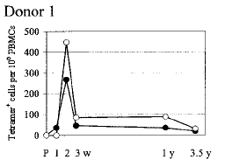
The IEDB catalogs immune epitope related experiments through manual curation of free text information into structured format
Epitope discovery contract submission
Literature curation
IEDB www.iedb.org
497,452 experiments
12,886 references
→ On track to curate all in scope articles by end of 2011

Slide 19
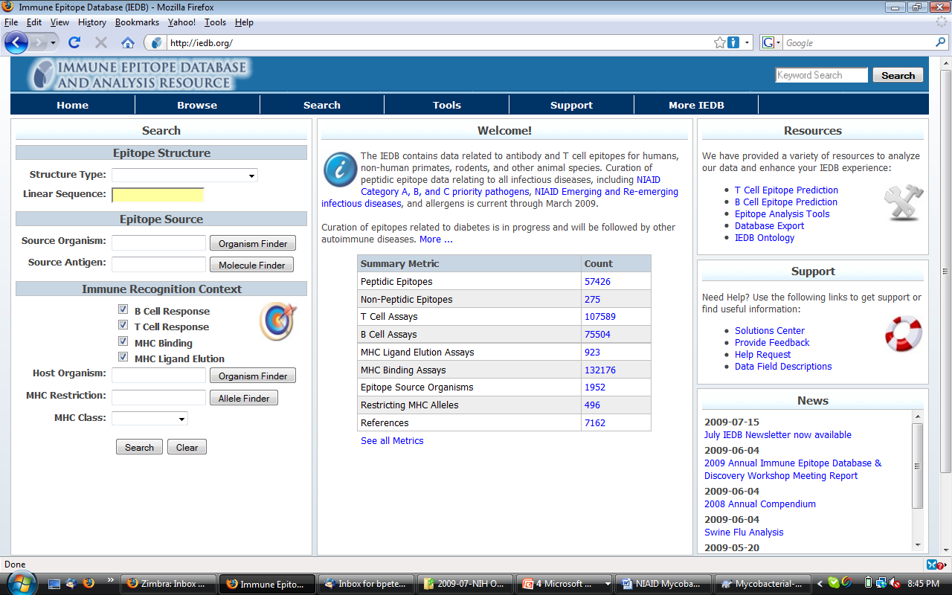

Slide 20
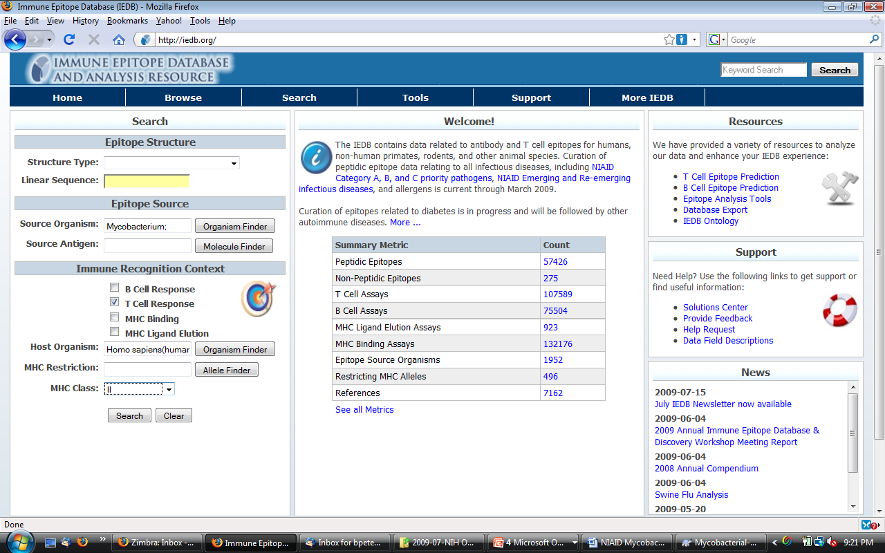

Slide 21
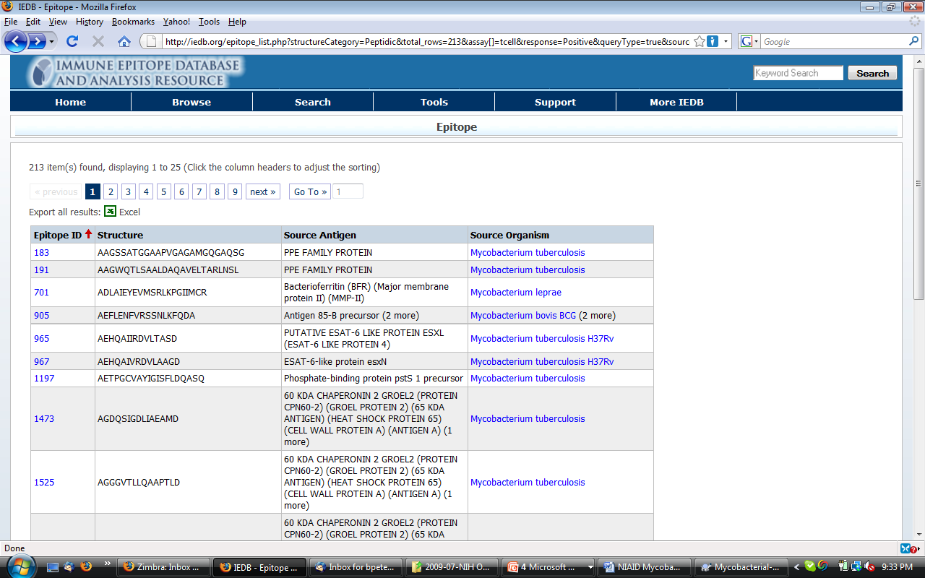

Slide 22
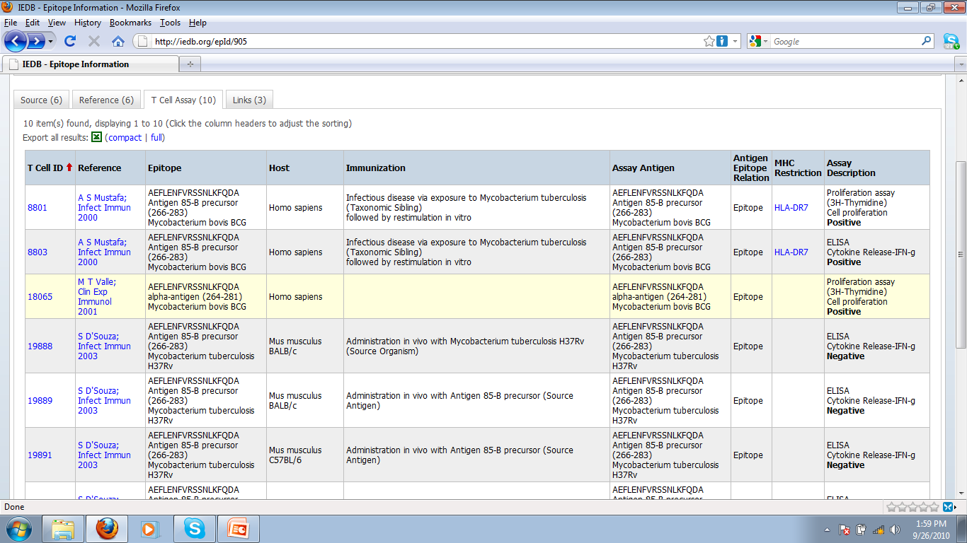

Slide 23
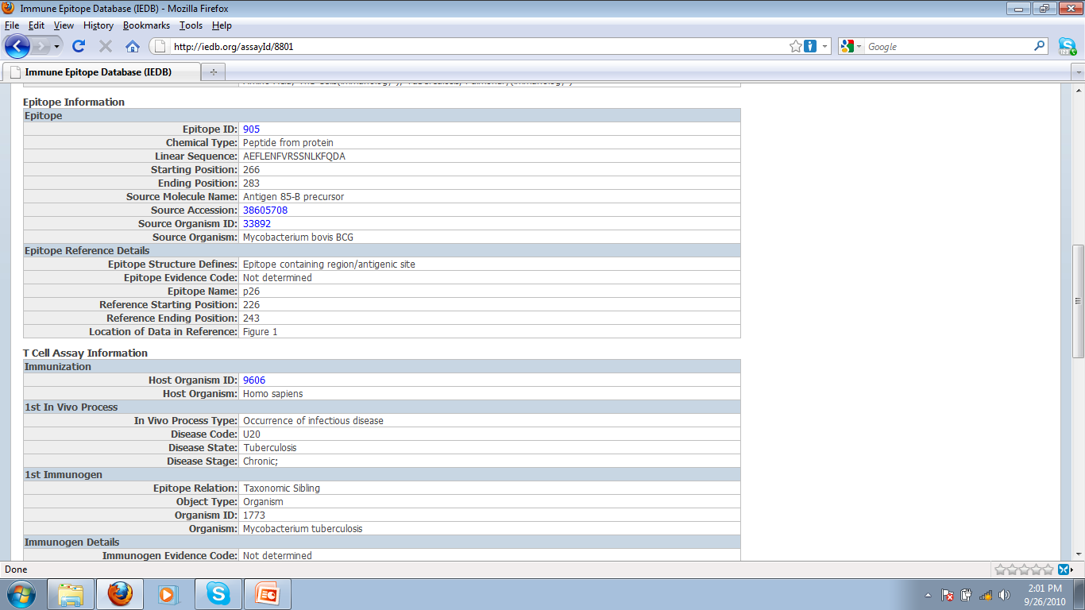

Slide 24
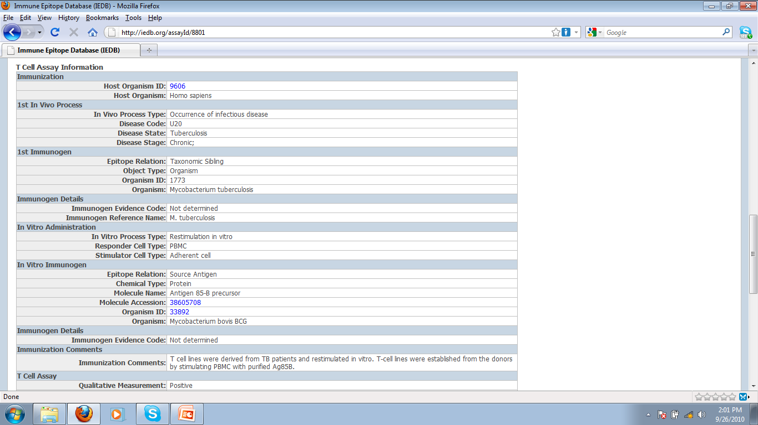

Slide 25
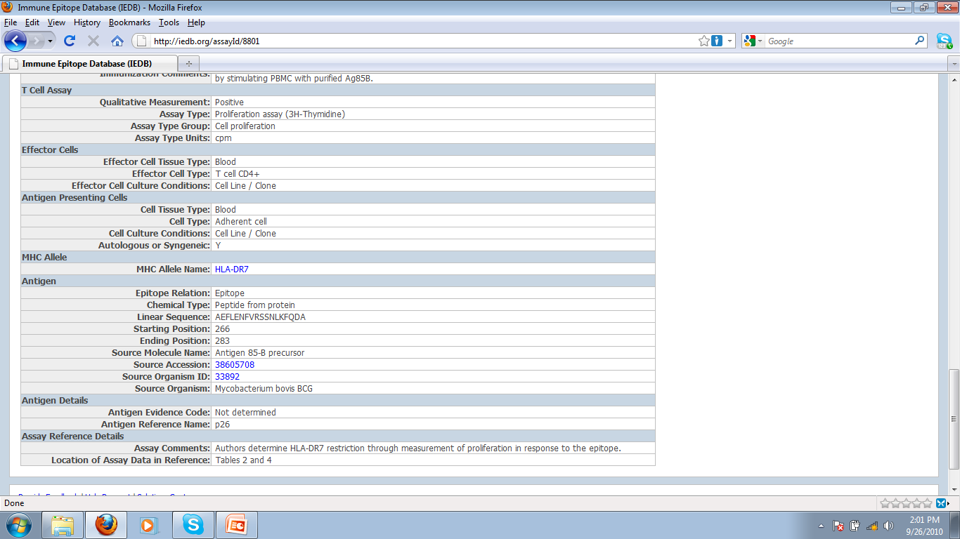

Slide 26
Original approach: controlled vocabularies
Use existing external ontologies /controlled vocabularies where possible (none available for epitope specific T cell assays)
Maintain list of assays; if a publication uses an assay that is different, add to this list → 140 T cell assays
Challenges encountered:
Ensure curators pick the right assays
Communicate to external users what each assay is
Avoid introducing duplicates (“MCP-1 IFA” = “CCL-2 histostain”)
In addition we want to
Search for groups of related assays
Interoperability (lots of it)
→ Create an OBI class for each entry in our list of assay types

Slide 27
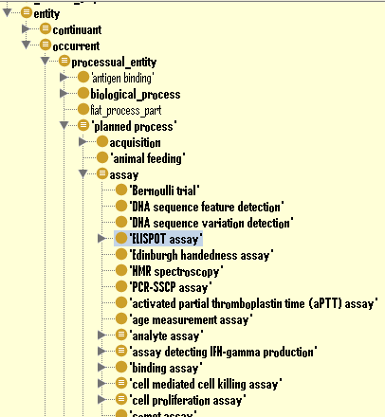
OBI hierarchy
Assay definition:
A planned process with the objective to produce information about an evaluant
OWL (partial):
has_specified_input some
(material_entity
and (has_role some 'evaluant role'))
has_specified_output some
('information content entity'
and ('is about' some
(continuant
and (has_role some 'evaluant role'))))

Slide 28
T cell epitope assay design pattern
Majority of assays could be defined with N&S conditions after specifying two variables:
<parent assay type> and has_specified_output some 'measurement datum‘ and 'is about' some (<GO process Y> and 'process is result of' some 'MHC:epitope complex binding to TCR')
For example: “IL-17 ELISPOT” in the IEDB is logically defined as
= 'ELISPOT assay‘ and has_specified_output some 'measurement datum‘ and 'is about' some (‘IL-17 production’ and process is result of' some 'MHC:epitope complex binding to TCR')
Required expanding parent assay types (OBI) and GO process

Slide 29
Adding parent assay types to OBI
label: cytometric bead array assay
definition: An assay in which a series of beads coated with antibodies specific for different analytes and marked with discrete fluorescent labels are used to simultaneously capture and quantitate soluble analytes using flow cytometric analysis.
alternative term: multiplexed bead assay, CBA assay
example of usage: Using a Luminex machine to detect IFN-gamma and IL-10 in the supernatant of a cell culture
“Parent” assay definitions are discussed in OBI as a group and derived by consensus, to ensure exactness and ability to re-use.
Child terms that follow design patterns are added without group discussion

Slide 30
Modifying external ontologies
Requests for new / modified terms are made through their respective trackers (sometimes additional prodding is needed)
Often results in email discussions that clarify issues and result in improved definitions (but take time)
Succeeded with GO, ChEBI, PRO, OGMS, IDO, PATO, UO, …
Resulting terms are imported into OBI to reference them in logical definitions (MIREOT mechanism explained more in hands on session)
Some terms have no natural home ontology, and are kept in OBI until they can be moved

Slide 31
Mapping IEDB assay types to OBI classes

Slide 32
Benefits of using OBI classes for IEDB assay types internally
Formal definitions of assay types serve as curation rules
Issues arising in curation are reflected 1:1 by issues in writing definitions
Linking to GO identified duplicate assay types (introduced in the IEDB controlled vocabulary as a result of changes in nomenclature over time)
→ The same could have been achieved by carefully writing definitions for our controlled vocabulary terms. But ontologies can do more…

Slide 33
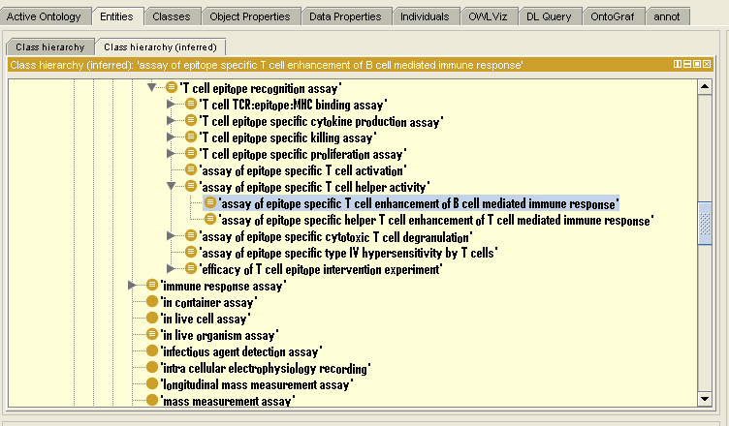
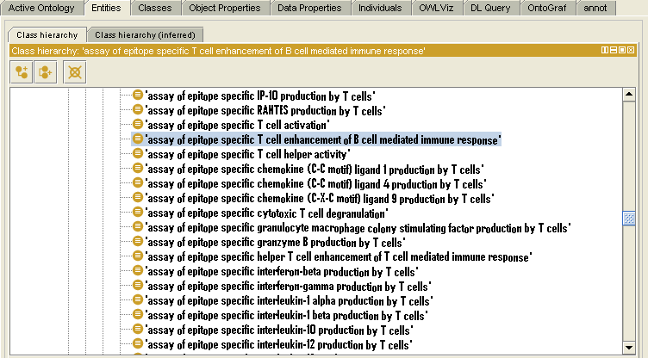
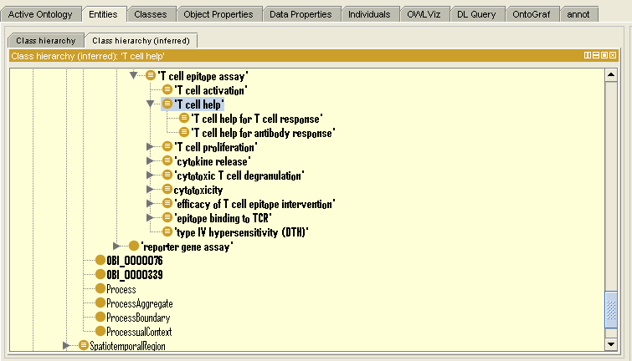
Reasoning introduces hierarchy
Display with community specific “IEDB alternative label”

Slide 34
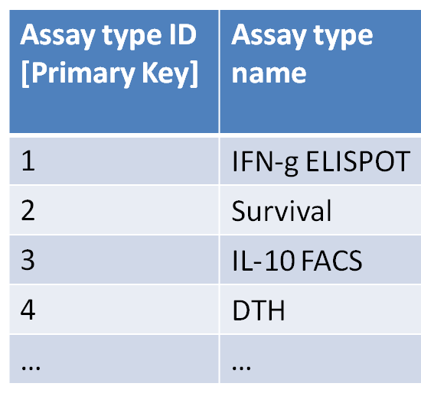
Benefits of using OBI for external users
Required (minimal) modification of the assay type table
Assay type ID [Primary Key] | Assay type name | Ontology ID [could be more than just OBI]
1 | IFN-g ELISPOT | http://purl.obolibrary.org/obo/OBI_0001414
2 | Survival | http://purl.obolibrary.org/obo/OBI_0001334
3 | IL-10 FACS | http://purl.obolibrary.org/obo/OBI_0000414
4 | DTH | http://purl.obolibrary.org/obo/OBI_0002114
… | … | …
→ This allowed us to use OBI

Slide 35
IEDB assay
Identification of duplicates in writing definitions
Definitions provide curation rules

Slide 36
Old vs. new assay finder
Show: from list to tree; search by grouping
Show: use of community labels (community view of OBI)
Refer to second session? Alternative mechanisms of using community specific labels (as annotation properties in OBI.owl, or in external spreadsheet)

Slide 37
Future work
Show: Sparql query against IEDB export
→ interoperability
Show: link to OBI for assays provides definitions

Slide 38
Lessons learned
Challenges:
Ensuring consistency in curation (document what each assay is)
Ensuring external users get what they expect when querying
Interoperability
Avoiding duplicates (MCP-1 IFA = CCL-2 histostaining)
Searching for groups of related assays

